Slide 1
Getting started with Reactive Extensions (Rx), Reactive UI and Xamarin

Slide 2

Hello!
Ben Ishiyama-Levy
Microsoft & Xamarin MVP
Captain @ Xamariners
Community Leader
Tech Speaker
@xamariner

Slide 3
What is Reactive Programming ?
Notes:
Have you ever been dealing with .Net events
or instantiate an object with delegate parameter (for callback, for example) ?
=> Code executed to response of external trigger

Slide 4
Interactive vs Reactive
Producer
Interactive
Reactive
Consumer
Notes:
Producer produces data
Consumer care about producer data
REACTIVE SYSTEM:
Producer invoke Consumer (event / delegate)
Producer decides, not you
INTERACTIVE:
Consumer interacts with producer
Consumer may have no idea when to check in on producer => polling
Context: small parts of larger system

Slide 5
What is The Problem ?
Notes:
Have you ever been dealing with .Net events
or instantiate an object with delegate parameter (for callback, for example) ?
=> Code executed to response of external trigger

Slide 6
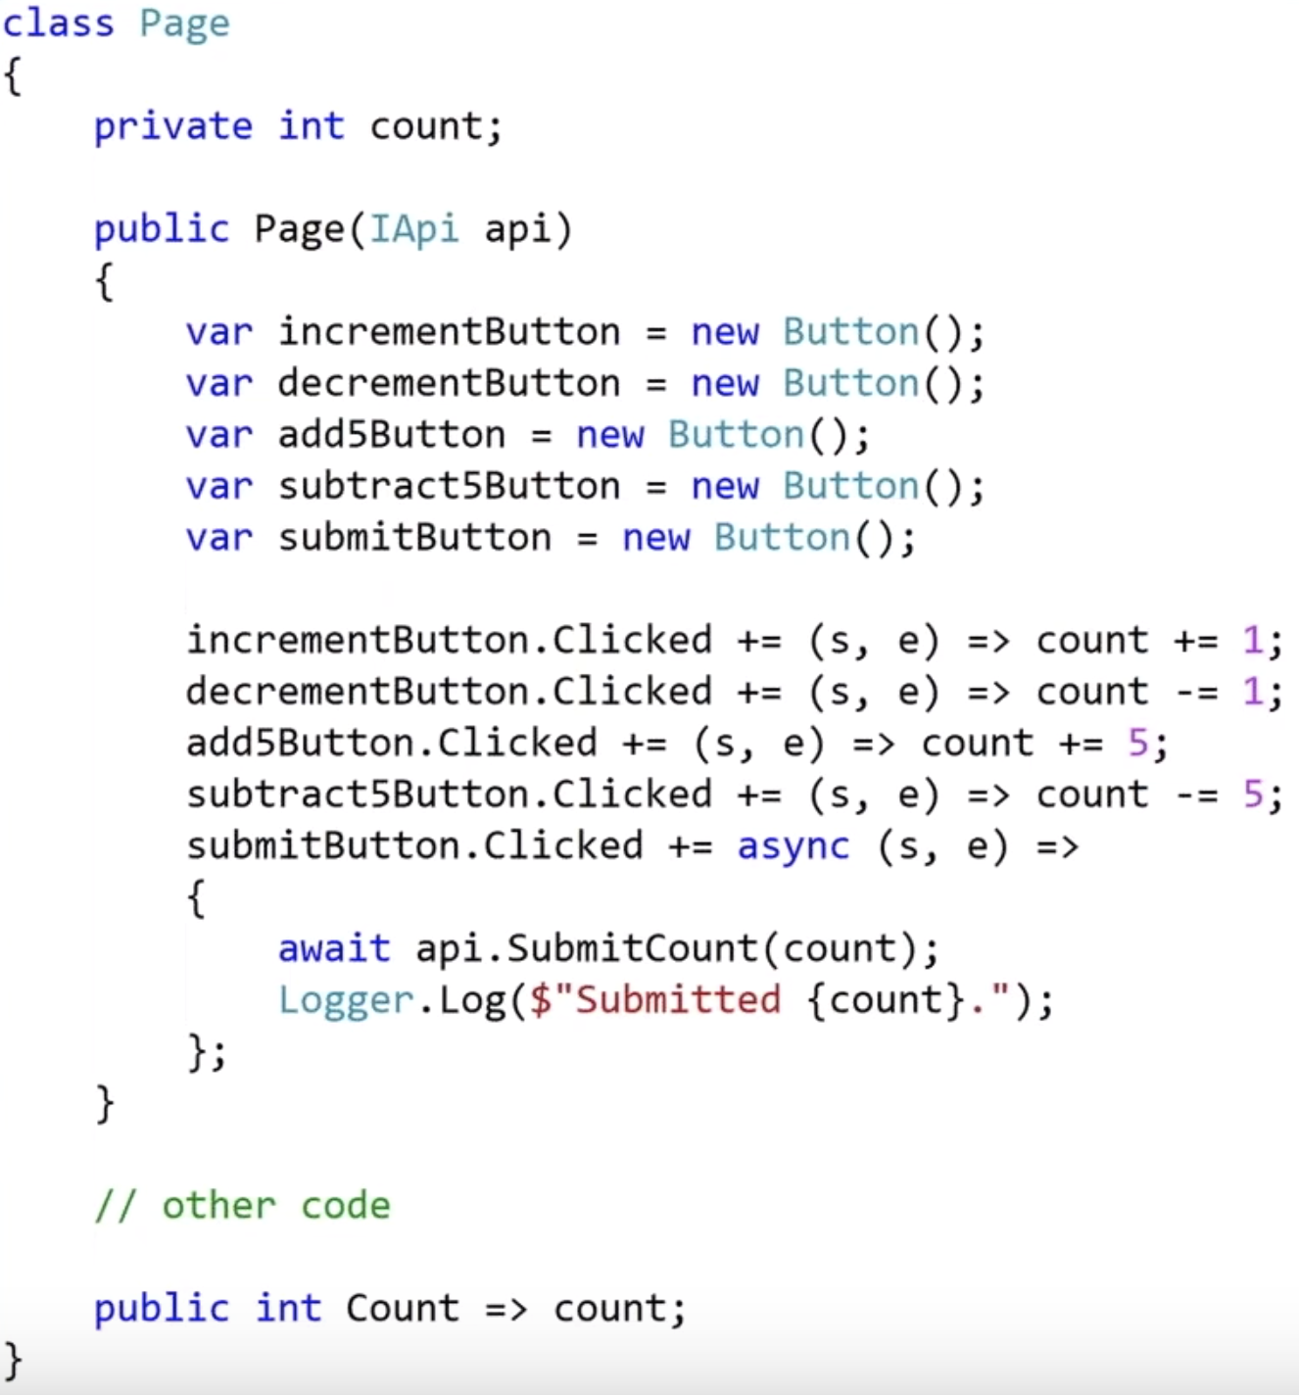
Raw Reactive is Imperative
Notes:
Problems:
Handling event async – when goes wrong, the event source won’t be notified (Handler is Sync) . Press button : Done
Bug on. Shared state. What is logged may not be what has been submitted (click when api has been fired)
Difficult to see what affects the count state

Slide 7
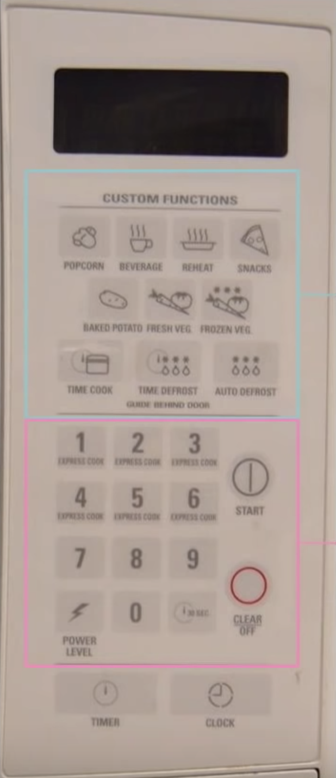
Imperative vs Declarative
Declarative: This is What I Want
Imperative: Do this
Notes:
Imperative: say exactly what you want
Declarative: Tell what we have and Microwave will do its best
Declarative is not limited in software like in this interface ( what is you don’t like pop corn )
LinQ : Clear & Understandable Declarative
Instead of telling the computer exactly what to do, declarative approach would be beneficial

Slide 8
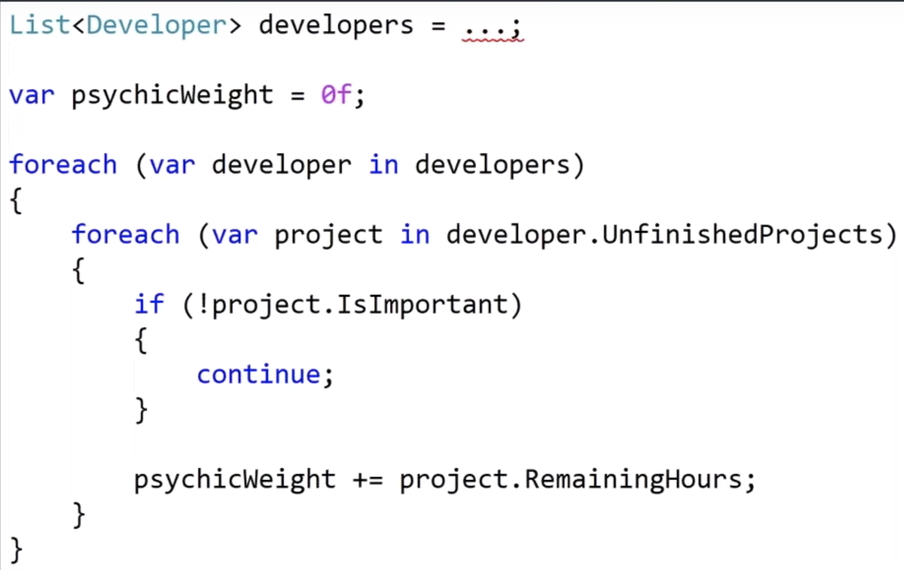
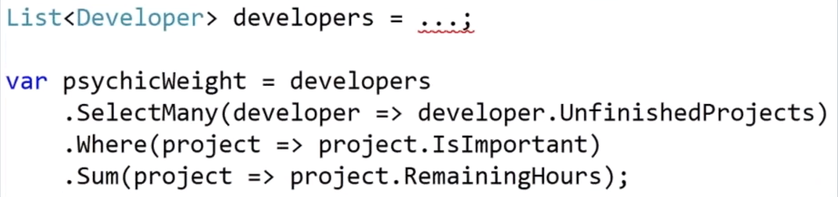
Imperative vs Declarative
Imperative: Do this
Declarative: This is What I Want
Notes:
What code is easier to read
Did LinQ change the way you program?

Slide 9
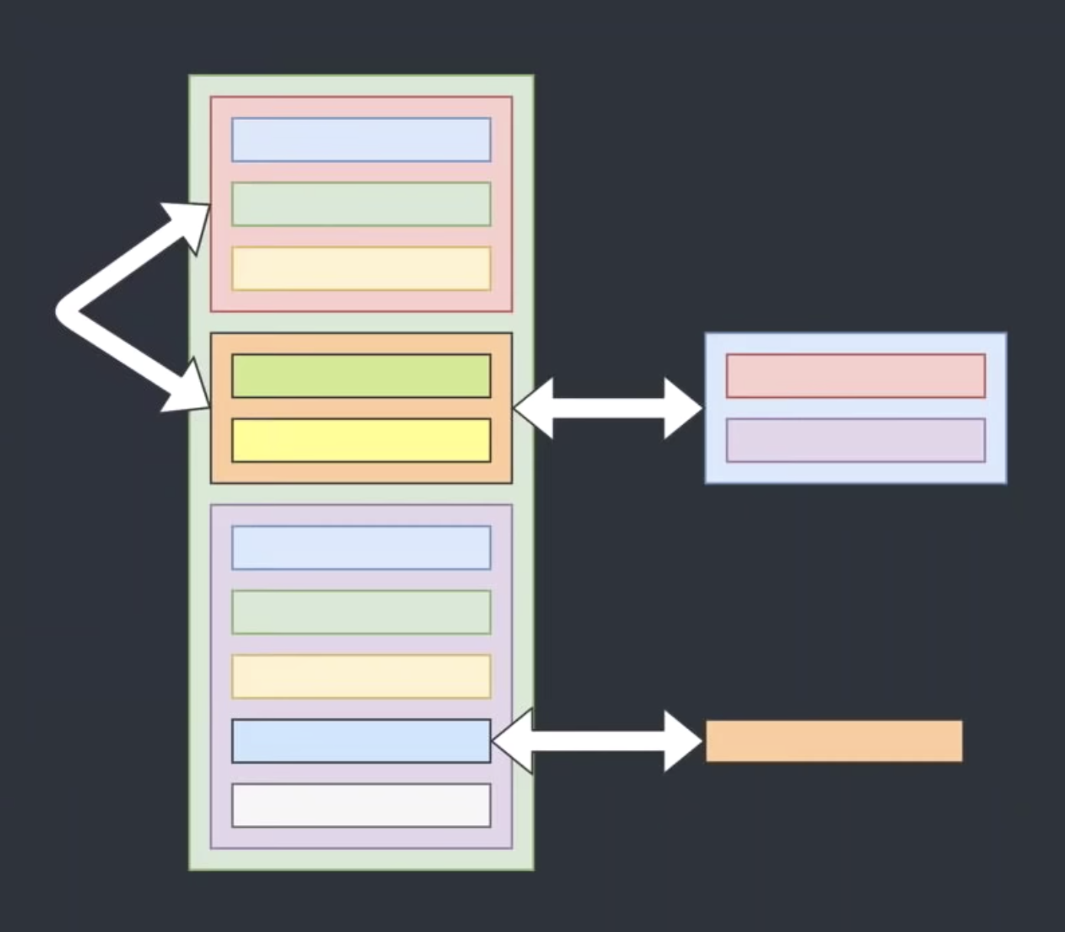
Composability
Notes:
Reactive programming with events and delegates: no composability:
‘How easy is it to rearrange the constitents of a software
Ex: logger : easy to add additional loggers, or remove
Reactive with events : how easy is it to move the handler for the ‘buy’ button

Slide 10
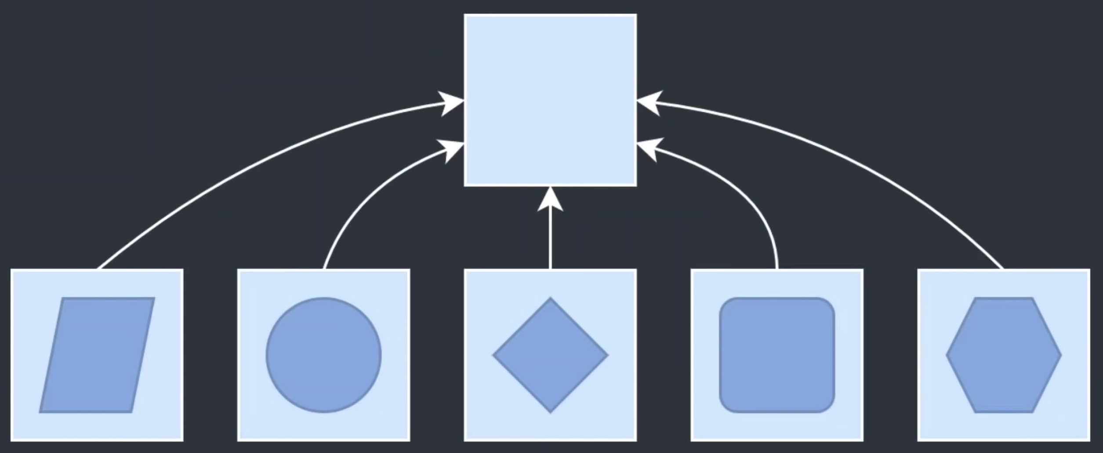
Abstraction and Unification
Notes:
Abstraction:
Identify and simplify to get to minimun behavior and data for a system
that can be used for any implementation : unifies
Ie: Interface and its implementatiob
Events are not abstract as each has its strongly typed payload
Can’t unify
Same for delegates

Slide 11
Time
Notes:
Relationship recognized between changes to state and time
Async operations : key is time

Slide 12
What is Rx

Slide 13
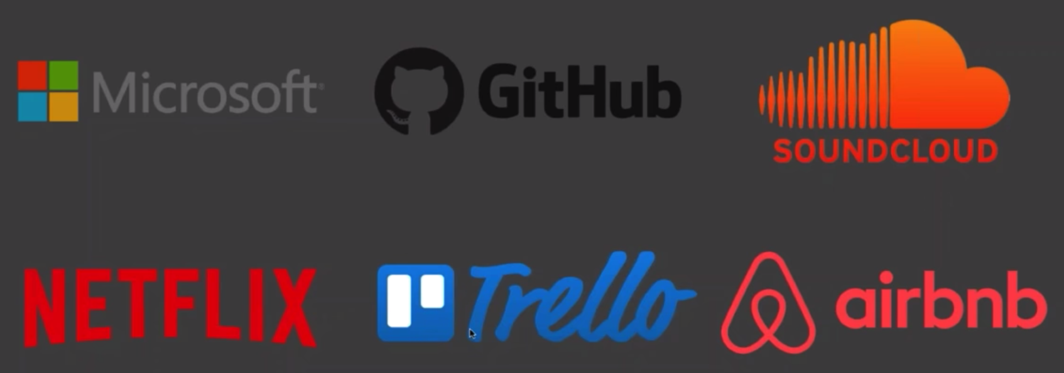
Who uses Rx

Slide 14
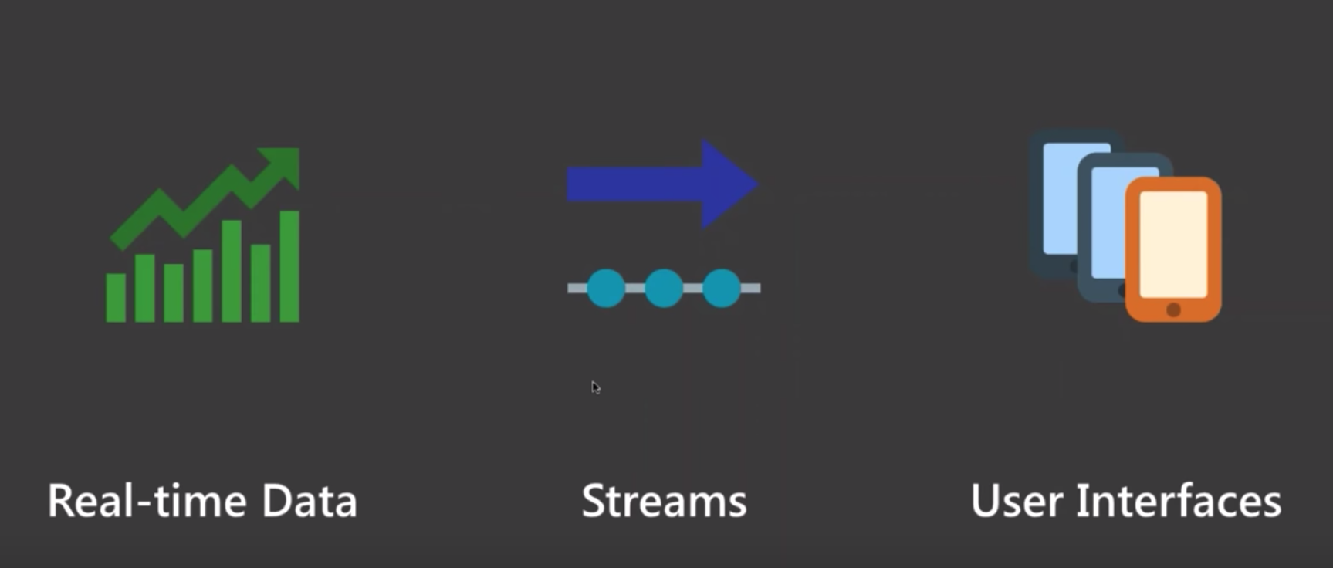
Rx Usages
Notes:
Real time data: stock / twitter => costant flow
Trad: timer / async…
Great for UI : interactions
Help listen / filter / merge…

Slide 15
What is Rx ?
Rx = declarative && composable == unified && reactive
Notes:
Clear means to express intent
Highly composable
Formalizes time
Helps orchestrate related and unrelated stimuli
Model these with same fundamental abstraction

Slide 16

Push vs Pull
Pull (Interactive)
Push (Reactive)
IEnumerable
IObserverable
Give me Data
(Fetch)
Call Function
Event Handler
Here’s some data
(Subscribe)
Notes:
Clear means to express intent
Highly composable
Formalizes time
Helps orchestrate related and unrelated stimuli
Model these with same fundamental abstraction

Slide 17
Push vs Pull
Pull (Interactive)
Push (Reactive)
IEnumerable
IObserverable
Give me Data
(Fetch)
Call Function
Event Handler
Here’s some data
(Subscribe)
Notes:
Clear means to express intent
Highly composable
Formalizes time
Helps orchestrate related and unrelated stimuli
Model these with same fundamental abstraction

Slide 18
IEnumerable<T>
Core interface for objects like List<T>
Provides as way to iterate through items
Generally comes as prepackaged data
that we open up and comb through
We PULL data from it

Slide 19
Typical IEnumerable<T> Usage
var people = await PersonRepository.GetAllPeopleAsync();
foreach (var person in people) {
Debug.WriteLine ($"{person.LastName}, {person.FirstName}");
}

Slide 20
IObservable<T>
Pushes data to subscribers
Like a conveyor belt or a stream
May or may not have an end
Values can be processed with LINQ

Slide 21
Example Observables
Observable.Range (1, 100);
Observable.Timer (TimeSpan.FromSeconds (3));
Observable
.FromEventPattern<EventHandler<TextChangedEventArgs>, TextChangedEventArgs> (
x => textEntry.TextChanged += x,
x => textEntry.TextChanged -= x
);
Notes:
Real time data: stock / twitter => costant flow
Trad: timer / async…
Great for UI : interactions
Help listen / filter / merge…

Slide 22


Subscribing
Gets values from IObservable<T>
Each value processed using Action<T>
Can have multiple subscriptions
Unsubscribe using IDisposable

Slide 23


Example Subscriptions
Subscriber<Fish> Observable<Fish>

Slide 24
Example Subscriptions
var fishSubscription =
fishObservable
.Subscribe (fish => Debug.WriteLine($”{fish.Name}”));
fishSubscription.Dispose ();
var fishSubscription =
fishObservable
.Where(fish => !fish.IsCrustacean)
.Select(fish => fish.Name)
.Subscribe (name => Debug.WriteLine($”{name}”));
fishSubscription.Dispose ();

Slide 25
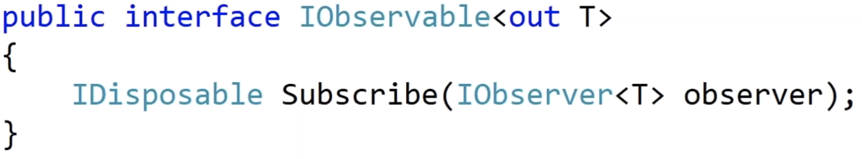
IObservable<T>
Notes:
Register an Observer that listens to Observable
Returns that subscription
When disposed, detaches the observer (ie unregister handler)

Slide 26
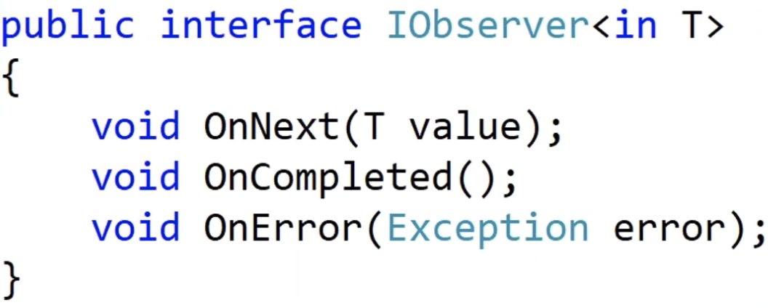
IObserver<T>
Notes:
Anything that wants to observe events of a given type
OnNext: each time a new item becomes available : 0 or infinity
OnCompleted: completes without error : nonce
OnError:: something goes wrong : nonce

Slide 27
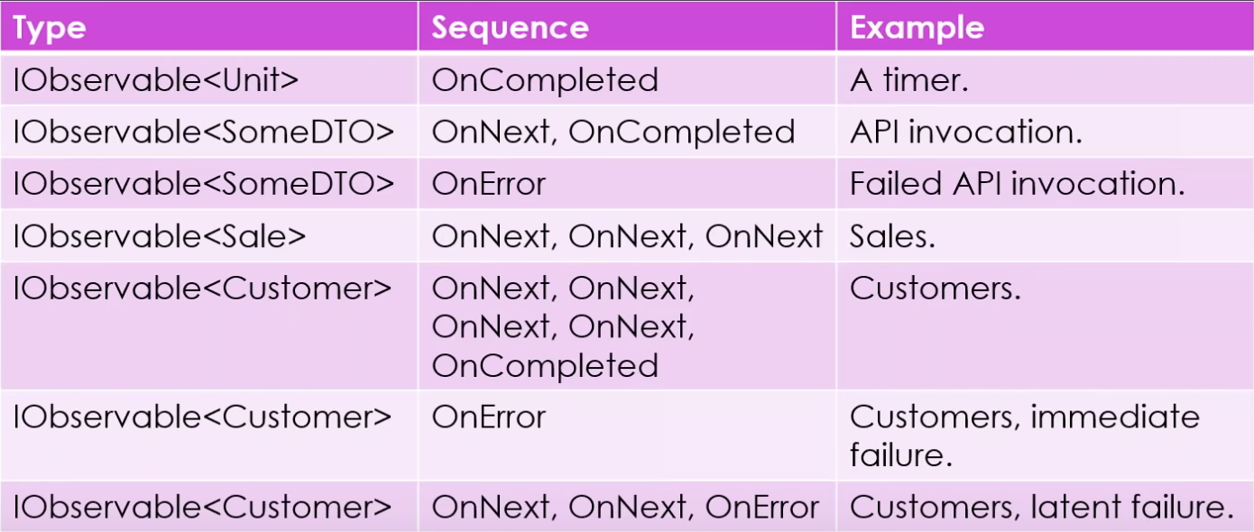
Examples
Notes:
Sales: infinite as n sales feed
Customers: ie customers within a given day.
Something goes wrong before any customer is received
A few customers are in before error

Slide 28
Operators

Slide 29
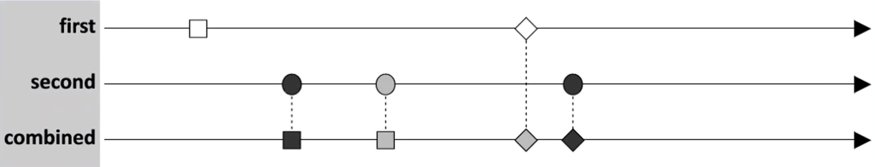
Operators
Notes:
Extension methods that Take and return an Observable Building block of Rx
Can define own Operators as just extension Methods\
Time is left to right

Slide 30
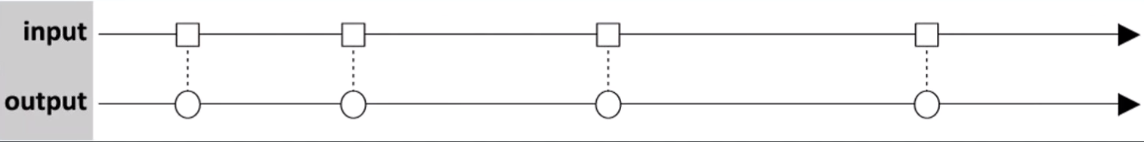
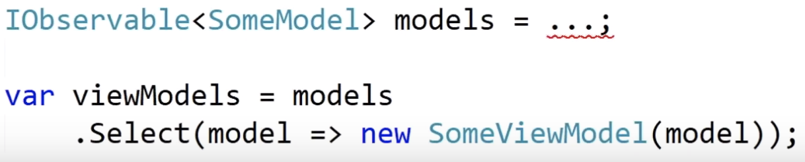
Select Operator
Notes:
Select a circle from a Square
Ex: select a viewmodel from a model
It is an observable, so could be hours between models being received

Slide 31
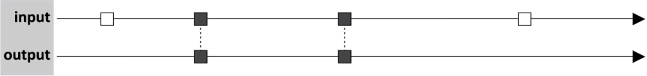
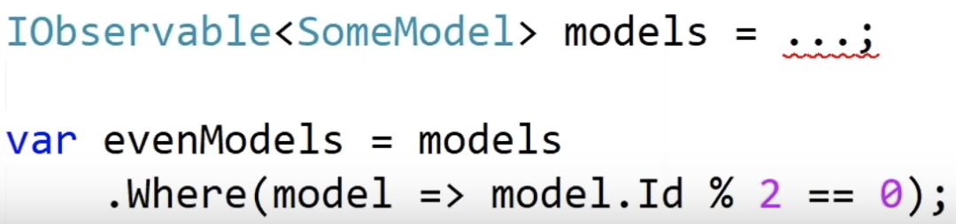
Where Operator
Notes:
Filtered using a predicate

Slide 32
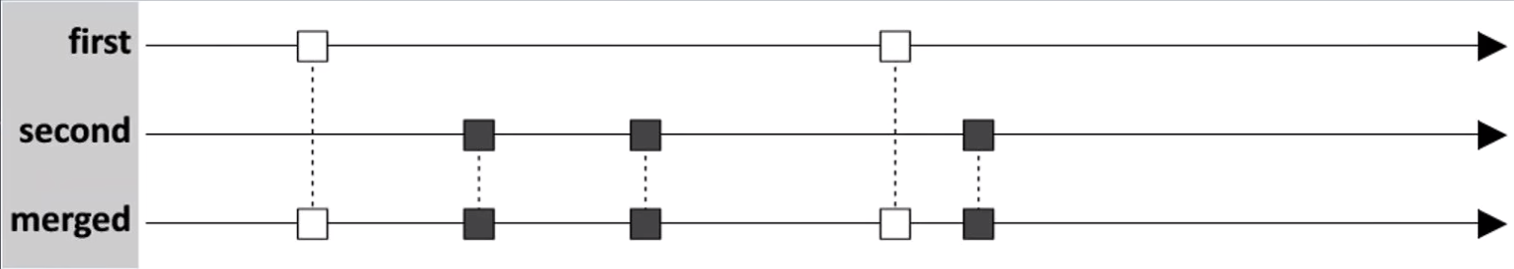
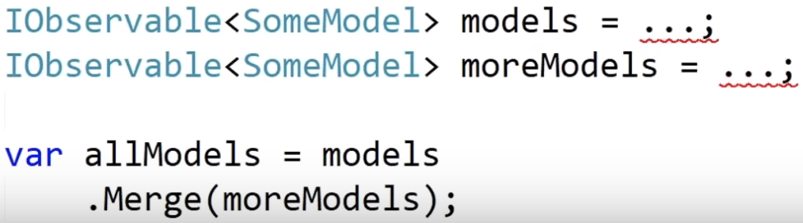
Merge Operator
Notes:
Filtered using a predicate

Slide 33
Many More Operator
SelectMany
CombineLatest
Switch
Throttle
Amb
Buffer
Scan
Distinct
Zip
Notes:
Filtered using a predicate

Slide 34
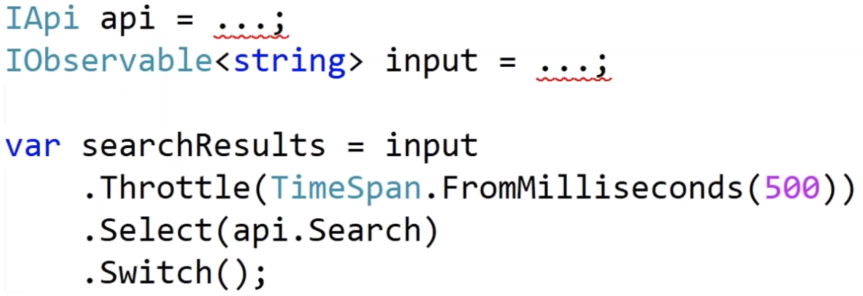
Example
Notes:
Unit testable
Rx allows to control time from test, such as fast forwarding

Slide 35
What is ReactiveUI ?
Notes:
UI lib / fx that brings power of Rx to UI dev
Easier and more productive
Pick and choose

Slide 36
ReactiveUI Platforms
.Net 4x
.Net Core
UWP
Xamarin.Android
Xamarin.iOS
Xamarin.Mac
Xamarin.Forms
Notes:
Abstraction for these platforms (nuget switch / bait)
ex: WhenActivated / Inactive

Slide 37
ReactiveObject
ReactiveObject
Notes:
Base class for anything that wants Property Change notification
Change and Changing observables corresponding to property Change and Changing events
Save converting a .net event into observable
Raise on change event -> check if different etc
Suppression of change notification event

Slide 38
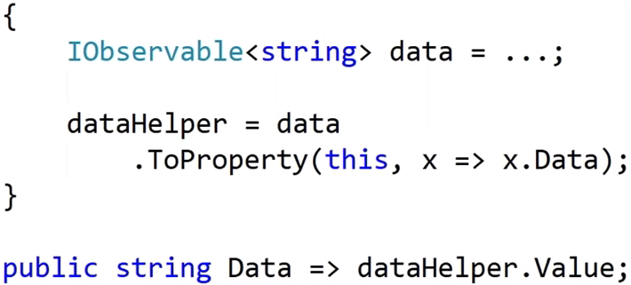
ToProperty
Notes:
Takes observable and casts do a property with change notifications
Change notification is raised when a new value is different to existing value

Slide 39
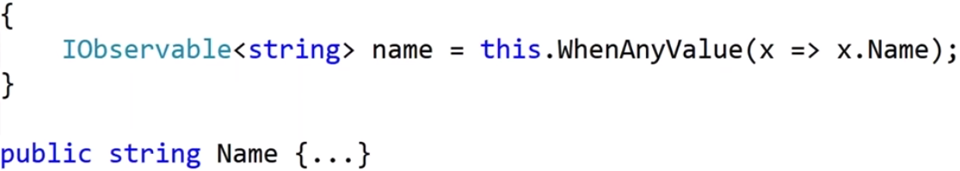
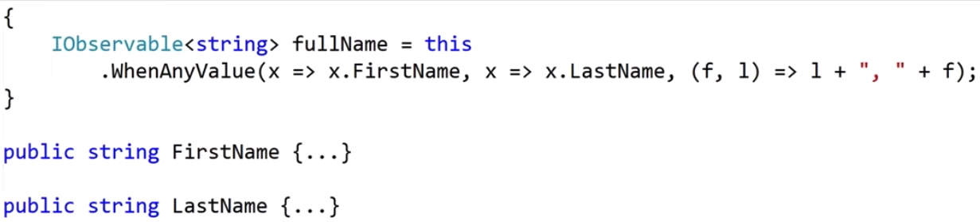
WhenAnyValue
Notes:
Property to Observable
WhenAny family
Most Common
Got Name property, and we want an observable whenever it changes
Supports many properties
Ex: concat

Slide 40
The WhenAny* Family
WhenAny
WhenAnyValue
WhenAnyObservable
WhenAnyDynamic

Slide 41
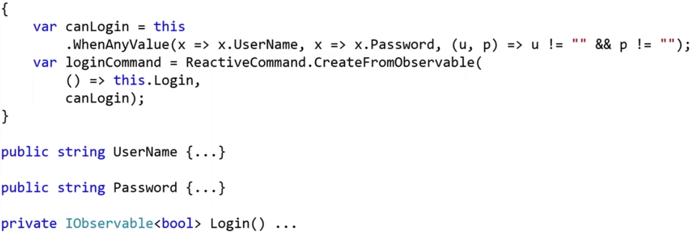
Reactive Commands

Slide 42
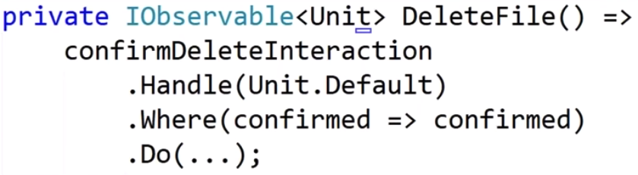
Interactions
Notes:
Allow for a ViewModel to await response to a quesrtion from view

Slide 43
Testability
Notes:
Control time and synchronization

Slide 44
Thank you

